Slide 1



trid
مسار الألعاب والفنون الرقمية
Let’s start!
Digitopia

Slide 2



agenda
1
8
Team
UI / UX and Visual Design
2
Executive Summary
9
Use Case Overview
3
10
Problem & Opportunity
Database & Data Model
4
Our Solution — TriD
5
Competitive Advantage
6
Technical Architecture
7
Business Plan

Slide 3



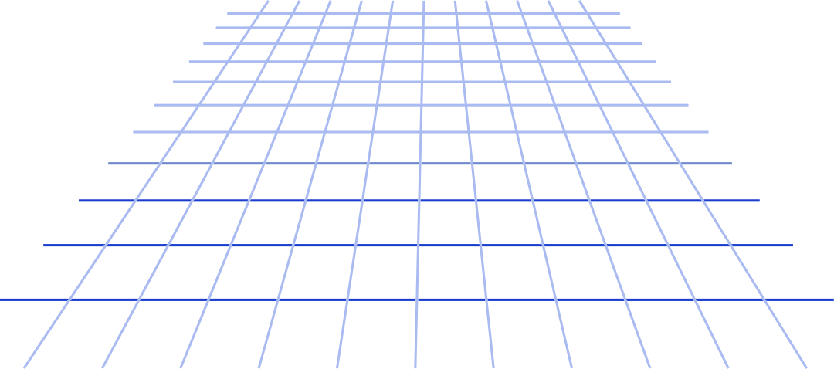
Meet the team
Rawan
Zeyad
Ahmed
Frontend
Frontend
Backend
3D Visualization Designer
VR Developer & 3D Interaction Designer
UI/UX
AI-powered 3D Animator
Blender Artist
Physics Engineer
Frontend Developer
Frontend Developer
Backend Developer

Slide 4
welcome!
TriD is a web shopping platform where users browse shops in 2D and enter them in 3D. Inside each shop, they can explore products in detail, view interactive 3D models, and shop with ease. It’s designed to make online shopping more engaging and accessible for everyone, including elderly people and people of determination.
Let’s begin!

Slide 5

future technology
Product focus: 3D product interaction, VR support, seller-managed shops, and in-scene advertising.
Target outcomes: increase income rates, reduce product returns, and provide an engaging brand storefront for retailers.
Current status: interactive mall, seller dashboard, core checkout flow, product storage integration.

Slide 6
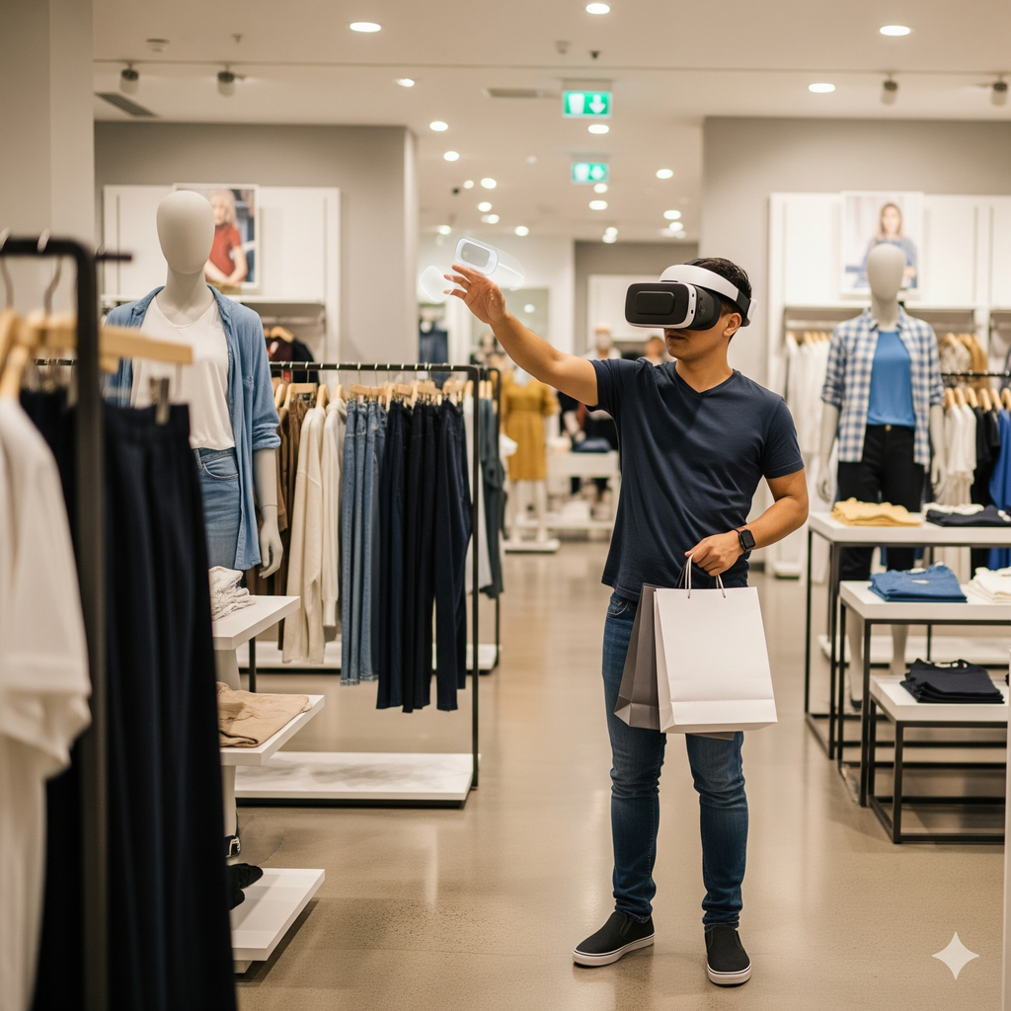
Problem & Opportunity
Problems with current e-commerce:
Customers cannot accurately judge size, quality, or aesthetic of products from 2D images.
High uncertainty leads to product returns and low income rates.
Retailers lack an engaging way to showcase products online.
The old people cannot go shopping which is not suitable for them.
Opportunity:
A realistic, interactive 3D shopping layer can bridge the gap between physical and online retail, increasing buyer confidence and unlocking higher-margin engagement models (in-scene ads, premium shop design).

Slide 7
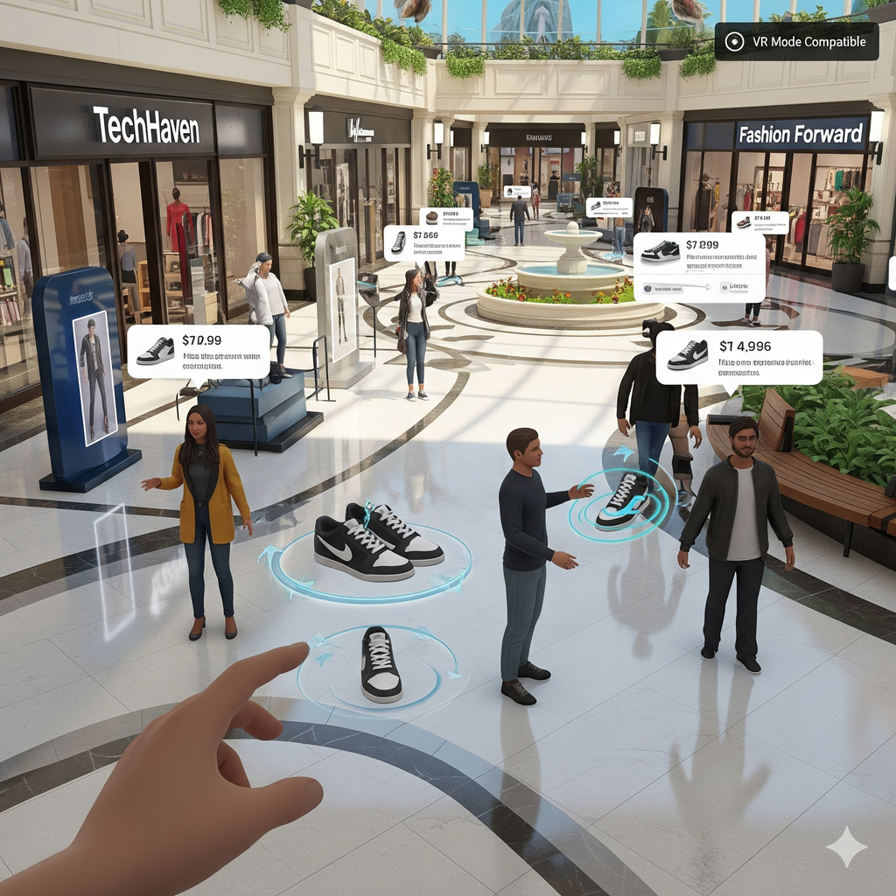
Our Solution
What TriD delivers:
A 2D mall interface where users browse and choose which shop to enter.
Interactive 3D shop environments with product models that users can rotate, zoom, and explore.
Seller dashboard: product CRUD, inventory management, and ad placement controls.
VR-compatible mode and keyboard/controller navigation for accessibility.
AI assistant (planned) to answer product questions and guide users.

Slide 8
Competitive Advantage
Immersion-first experience: Rich 3D UX optimized for web and VR, not just basic 3D viewers.
Seller tools & monetization: analytics for shop owners, & uploading 3D products.
Scalable architecture: Modular React + backend APIs making it easy to add stores and features.
AI & voice roadmap: Planned integration with conversational AI for in-scene help and voice TTS.

Slide 9
Technical Architecture
Frontend
Our frontend is designed to deliver an immersive and interactive 3D shopping experience:
React: Provides a declarative, component-based structure that simplifies UI development and ensures smooth integration with state management.
Three.js: A powerful WebGL-based 3D library used for rendering realistic graphics directly in the browser.
React Three Fiber (R3F): A declarative wrapper for Three.js that allows us to manage 3D scenes using React’s component model. It streamlines scene creation, improves performance with efficient rendering updates, and enables WebXR support for VR shopping experiences.
Backend
Our backend is designed to be secure, scalable, and production-ready:
Spring Boot: Provides a convention-over-configuration framework that accelerates development of stand-alone, production-ready applications. It enables us to build scalable and maintainable RESTful APIs efficiently, ensuring stability and high performance.
Spring Security: The industry-standard framework for authentication and authorization, ensuring robust protection for user data and secure access control across the system.
👉 Together, Spring Boot and Spring Security deliver a solid foundation for a reliable, secure, and enterprise-grade backend powering TriD.
Database & Storage
Our database layer ensures reliability, consistency, and smooth evolution:
PostgreSQL: A powerful open-source relational database recognized for its reliability and ability to handle complex queries and large datasets. It is ideal for managing structured data such as user profiles, product catalogs, orders, and shop configurations.
Flyway: A database migration tool that manages schema changes in a versioned, controlled, and repeatable manner. This is essential for collaborative development and ensuring consistency across production deployments.
👉 Combined, PostgreSQL and Flyway provide a stable, scalable, and well-managed database foundation for TriD.
Deployment & DevOps
Our deployment strategy ensures consistency, scalability, and high availability:
Docker: Provides containerization of application services by packaging code and dependencies into portable units. This guarantees environment consistency across development, testing, and production, while simplifying deployment and scaling.
Azure Cloud: A scalable and reliable cloud platform that hosts our Docker containers. Using services like Azure Kubernetes Service (AKS) or Azure App Service, we achieve automatic scaling, load balancing, high availability, and seamless CI/CD integration.
👉 Together, Docker and Azure Cloud enable a robust, flexible, and production-ready deployment pipeline for TriD.

Slide 10
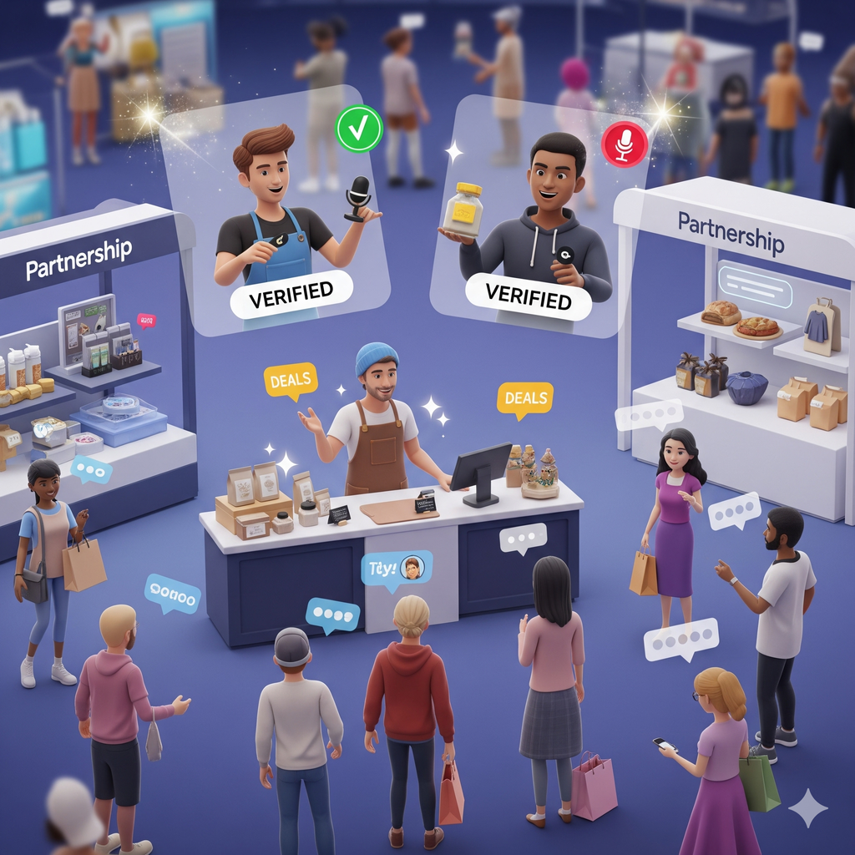
Business Plan
Target market: Online shoppers aged 18–60 and small-to-medium retailers seeking richer product presentation.
Go-to-market strategies:
Partnerships with fashion brands and local malls for exclusive 3D store launches.
Influencer demos and social campaigns showcasing virtual try-ons.
Customer acquisition: Content marketing, demo events, and targeted ads focusing on reduced returns and improved purchase experience.

Slide 11

UI / UX
Click Me

Slide 12
Use Case Overview
Purchase Item
Manage Shop Items
Admin

Slide 13
Purchase Item
Actor: User (Shopper)
Description: The user selects and purchases an item from a shop within the mall.
Trigger: User decides they want to buy a product.
Type: External
Preconditions:
The user is authenticated and logged into their account.
The TriD application is online and operational.
The user has valid payment information available or linked.
Normal Course:
The user choose the shop that he wants to buy from in 2D page
The user explores the shop and identifies a product of interest.
The user interacts with the product's 3D model to view detailed information (description, price, size, etc.).
The user adds the product to their virtual shopping cart.
The user navigates to the 'My Cart' section to review selected items.
The user initiates the checkout process.
The system presents a summary of the order and requests shipping and payment details.
8.The user confirms the order and submits payment information.
9.The system securely processes the payment.
The system confirms the successful placement of the order to the user.
10.The order details are recorded in the user's purchase history.
11.The system updates the shop’s relevant inventory and notifies the shop owner of the new order.
Postconditions:
A new purchase order record is created and stored in the database, linked to the user and the seller's shop.
The user receives confirmation of their purchase (e.g. on screen or via email).
The inventory count for the purchased item is reduced in the database.
The corresponding shop owner is notified about the new order via the seller portal.

Slide 14
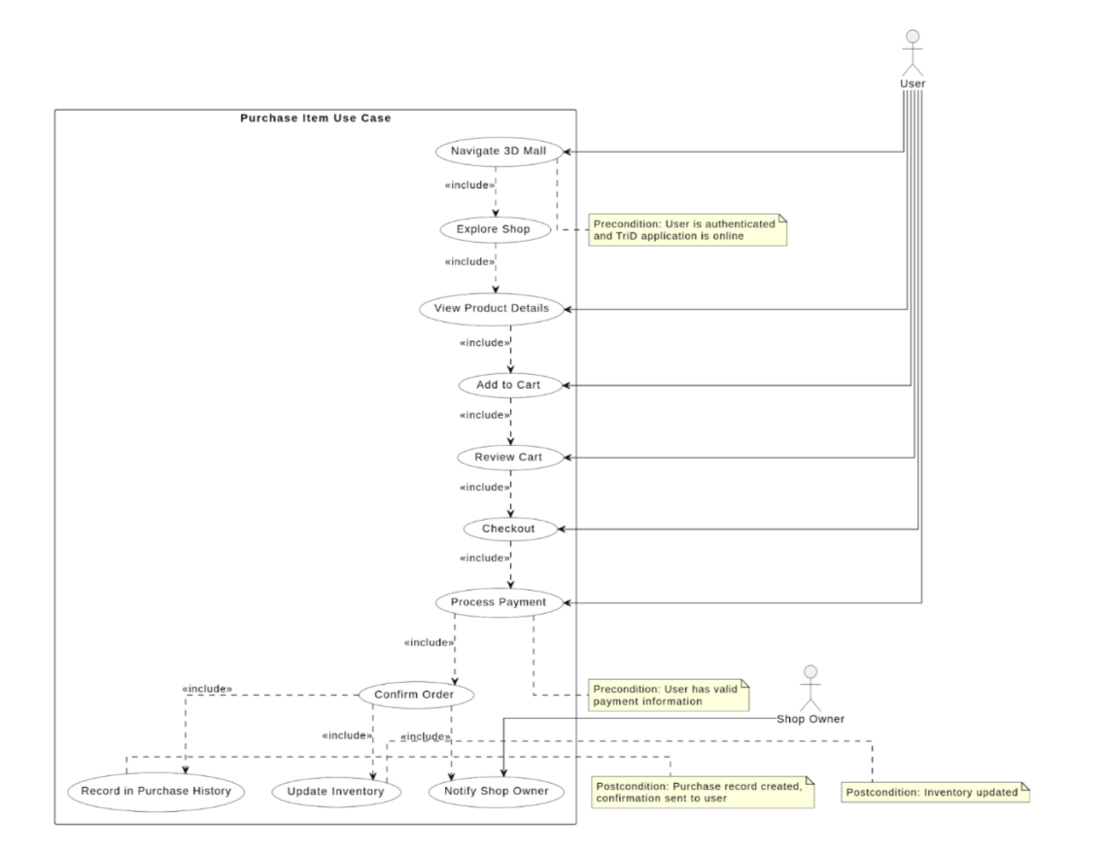
Purchase Item

Slide 15
Manage Shop Items
Actor: Seller
Description: A shop owner updates their virtual store's product catalog and manages advertisement content.
Trigger: The seller needs to add, modify, or remove products or update shop advertisements.
Type: External
Preconditions:
The seller is authenticated and logged into their account.
The seller owns at least one virtual shop in the mall.
The TriD application is online and operational.
Normal Course:
The seller accesses their personalized seller dashboard after logging in.
The seller navigates to the 'Product Management' or 'Shop Management' section for a specific shop.
To add a product: The seller initiates the 'Add New Product' process, uploads the 3D model, provides product details (name, description, price, inventory), and specifies its desired placement within the virtual shop environment (position, rotation, scale).
To update a product: The seller selects an existing product, modifies its details, updates the 3D model if needed, or adjusts its placement in the shop.
To delete a product: The seller selects an existing product and confirms its removal from the shop.
The seller may use the 'Shop Preview' mode to visualize the changes in the 3D environment.
The seller saves or publishes the changes made to products or advertisements.
The system validates and applies the updates to the shop's data.

Slide 16
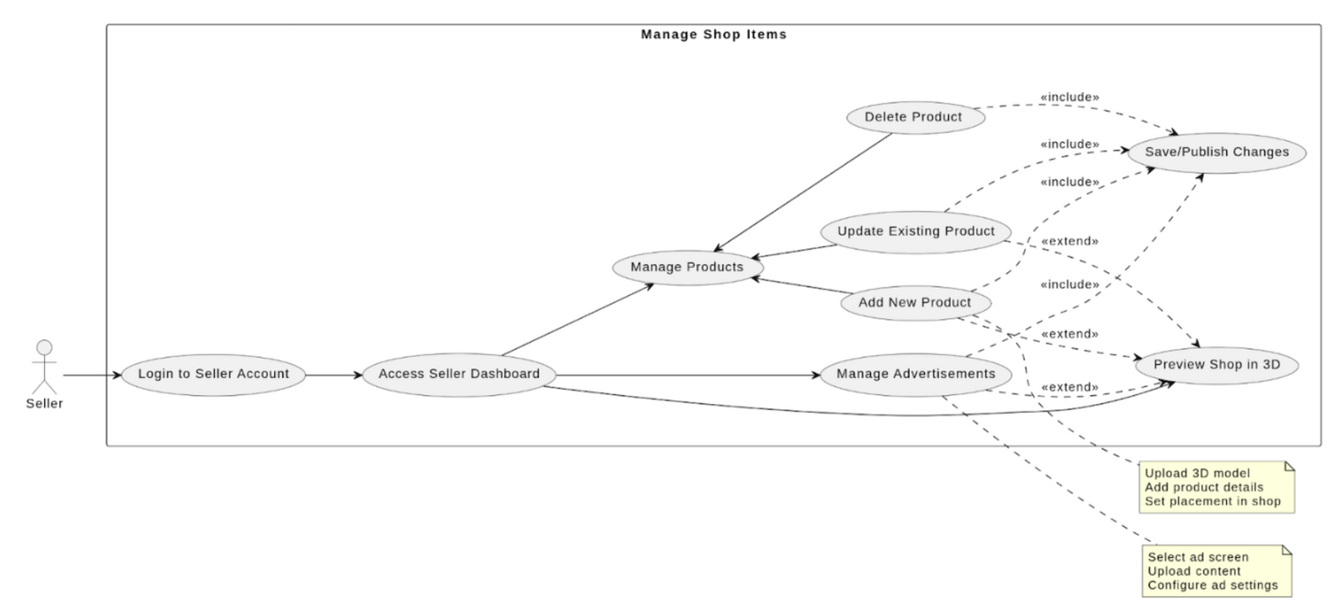
Manage Shop Items
Postconditions:
The product catalog for the seller's shop is updated in the database.
Associated 3D models and product metadata are stored or updated.
Changes are reflected in the virtual shop environment for shoppers upon refresh or next visit.
Shop statistics are successfully retrieved from the database and displayed to the admin.
Reports, if requested, are generated and made available to the admin.
No persistent state change occurs in the system as this is a read-only operationUse Case Name: Retrieve Shop Statistics

Slide 17
Admin
Actor: Admin
Description: An administrator accesses and reviews performance and activity statistics for registered shops on the platform.
Trigger: The admin needs to monitor shop activities or platform performance trends.
Type: External
Preconditions:
The admin is authenticated and logged into the admin panel.
The TriD application's backend is operational and collecting data.
Normal Course:
The admin logs into the administrative dashboard.
The admin navigates to the 'Shop Management' or 'Analytics' section.
The system displays a list of all registered shops within the mall.
The admin selects a specific shop from the list to view detailed statistics.
The system retrieves and presents performance metrics for the selected shop (e.g., total sales, visitor count, product views, order history summary).
The admin reviews the presented statistics.
Optionally, the admin may filter data by date range or export the statistics for reporting purposes.
The admin can navigate back to the list or view statistics for another shop.

Slide 18
Admin

Slide 19
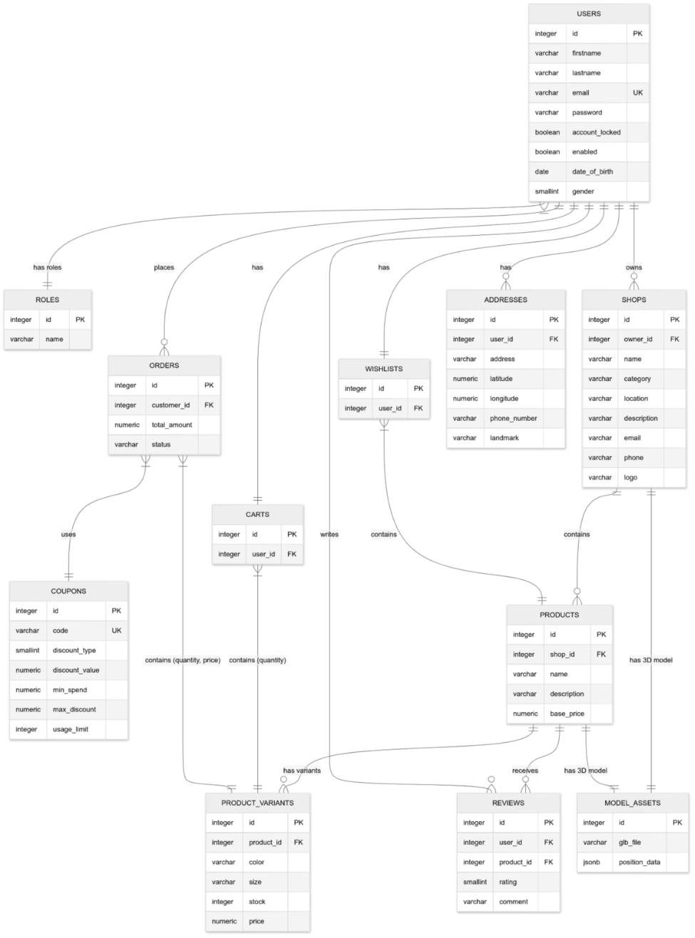
Conceptual ERD

Slide 20
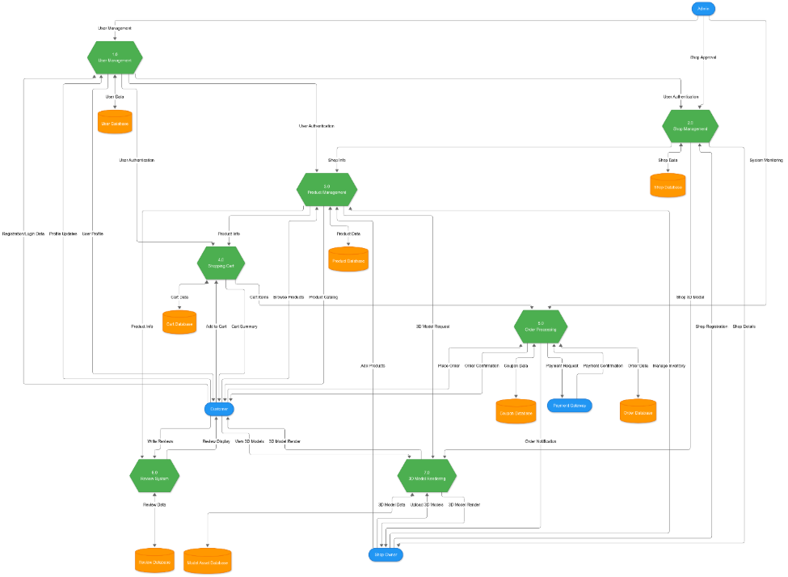
Data Flow Diagram

Slide 21
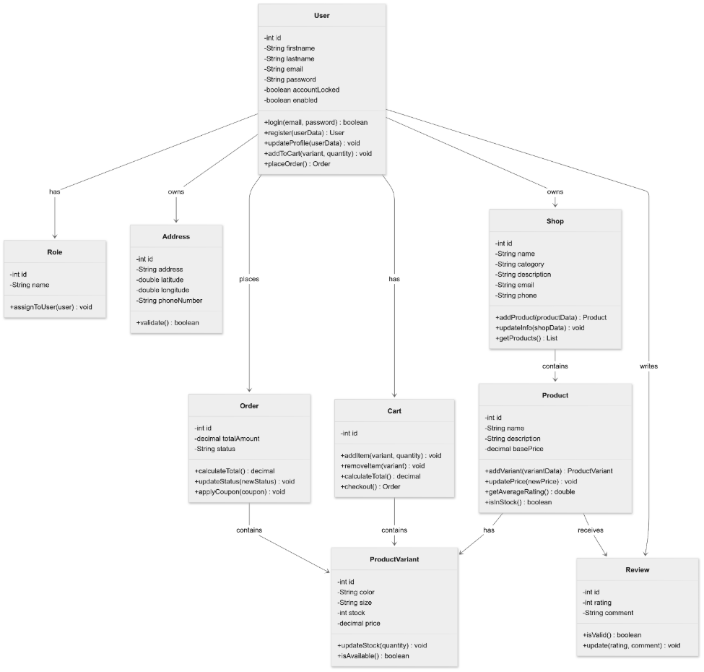
UML Class Diagram

Slide 22
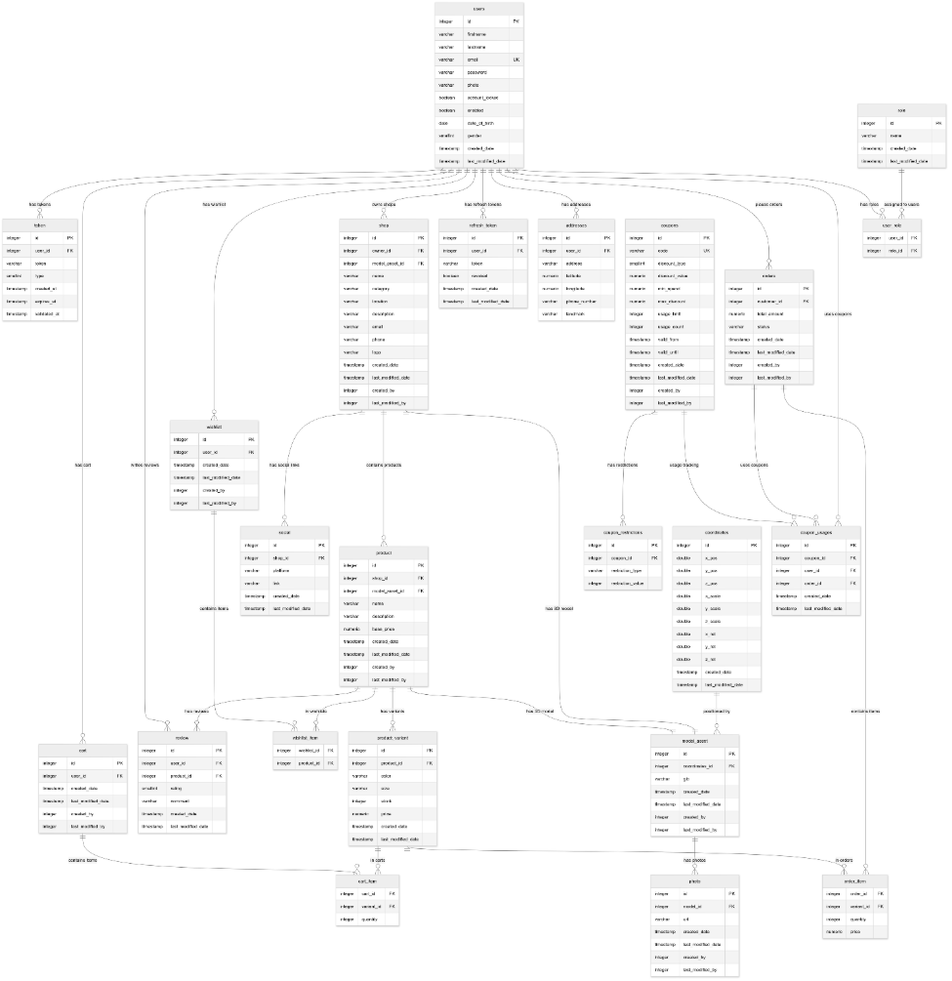
Physical ERD

Slide 23
Thank
you!

